Slide 1
IBM Services Platform with Watson Training Cognitive Delivery Insights (CDI)
Dominique Rossi-Chevrel - Executive IT Architect
GTS Technology Innovation and Automation team
This material was compiled from different GTS sources, thanks to CDI architecture, development and deployment team and SIH East team

Slide 2
Contents
Overview – what does it do, what is included and what is not?
Value Proposition – why should a client want this?
Common Scenarios – what are the most common use cases?
Delivery – what are the available delivery options?
Solution Design and Guidance – what do you need to look at during engagement ?
Further Help – what is the available documentation? who can provide further support?
Supporting Information – appendices with detailed supporting information

Slide 3


Cognitive Delivery Insights (CDI) is an Analytics capability for GTS managed accounts. It shows how services are performing, how and where they can be improved
Through a single pane of glass, CDI extends GTS managed accounts delivery acumen by providing a catalogue of analytics insights from the Operational Data of the managed accounts. This data is stored in a GTS Data Lake
The operational data is collected by the different tools that manage the client’s environment and stored in the data lake. The environment could be of any of the following types - traditional, cloud, hybrid – as far as the management tools are integrated into CDI. The operational data is historical, real-time and curated operational data
The analytics insights are derived from this operational data and stored within the data lake - automation content, patterns, meta data, e.g. data catalogues, taxonomies, classifiers, rules. These insights can correlate data from the multiple data sources to extend delivery insight for a given client and also get cross accounts insights. All these insights enable improved decisions, increased control of operations and improved communication.
2
Client Insight Dashboards
Cognitive Delivery Insights (CDI)
ITaaS Environment
Design
IBM Watson
Client Workloads
Composable Services
Manage
Traditional IT
Private Cloud
Public Cloud
Optimize
1
Data Lake
Designing superior IT solutions to more rapidly and effectively deliver on business objectives
Managing IT operations to keep the environment healthy and always-on
Optimizing IT performance to continuously improve business outcomes

Slide 4
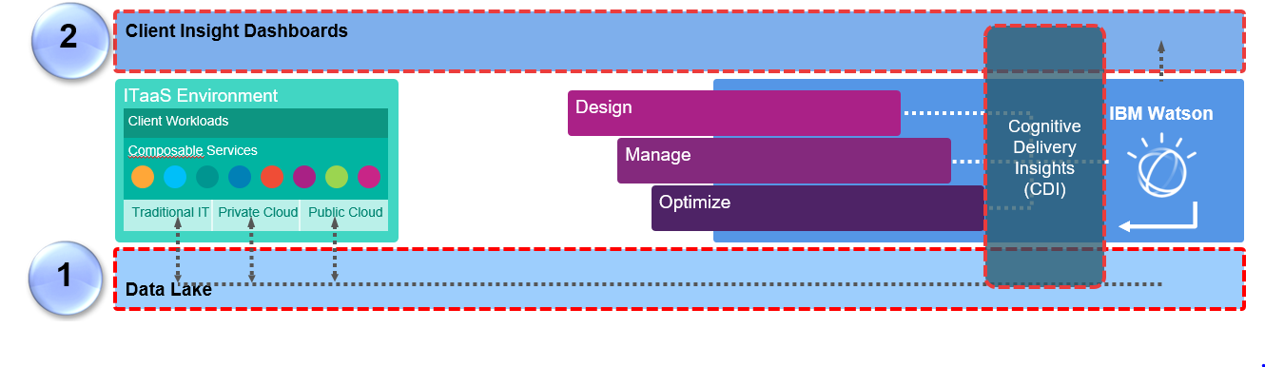
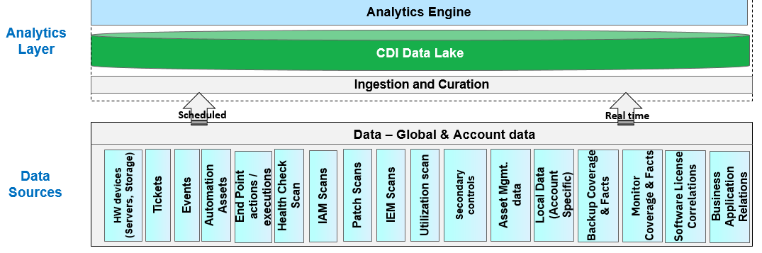
CDI Data Lake scope
Tools used by the different management services (incident management, event management, capacity management, asset management, automation, etc..) provide both historical and real time information on the client’s environment. They collect an important volume of information and key data for their services.
CDI is connected to a growing number of
data source domains (for instance IPC ticketing domain, event management domain, automation domain)
data source types for each domain (for instance for the IPC ticketing domain : ICD, ServiceNow, Remedy, SMIW, Manual)
data source instances for each data source type (e.g. the different ICD shared instances at a Geography level and dedicated instances)
CDI provides also a self-service to enable manual upload of Service Tickets, Events, Change Requests, Utilization and PTA for accounts that do not have / cannot have real time updates.
The data from the data sources is regularly pulled by ETLs or using Integration Service Adapters or using Streams pull capability and stored in the CDI Data Lake.
This repository is used by the various available insights, mapped to domains, within the CDI catalog
Cognitive Delivery Insights (CDI)
Client Insight Dashboards
Management Services tools
Traditional IT
Private Cloud
Public cloud

Slide 5
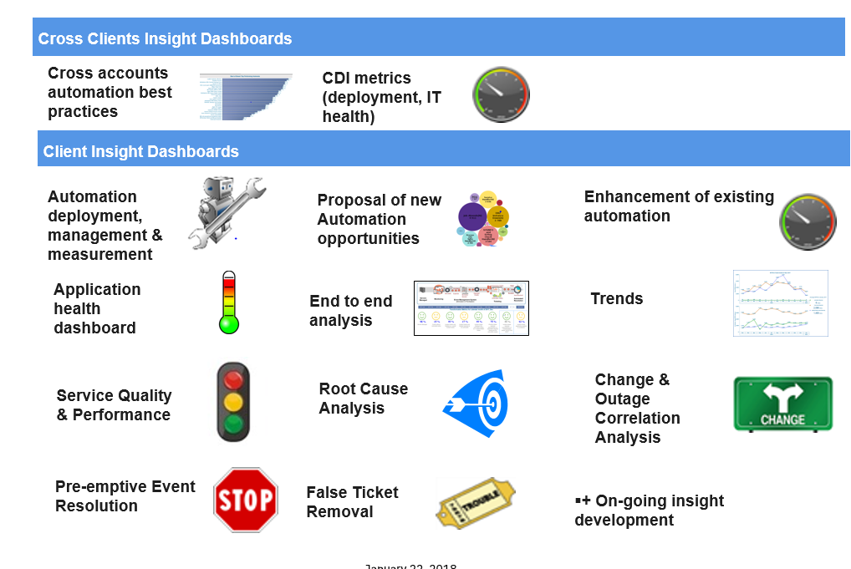
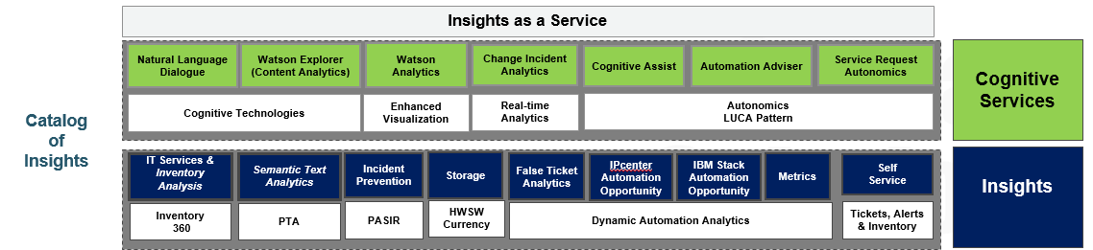
Scope of Cognitive Delivery Insights
CDI delivers a catalogue of deep and meaningful analytics insights that drive overall service improvement and automation coverage:
Relevant insights that will make a material difference on the quality of the service for an account and cross accounts.
Correlation between multiple data sources to build an end to end view of the service health, trends
Intuitive navigation
Insights to not only drive and measure automation improvement, but remove the causes of trouble.
Cognitive Delivery Insights (CDI)
Insights
IBM Watson Advantage:
Watson visualization used to deliver intuitive and standardized visibility across multiple subjects.
Watson used to interpret and analyze non-structured data: mails, ticket descriptions, client feedback etc.
Analytics engine
Data Lake

Slide 6
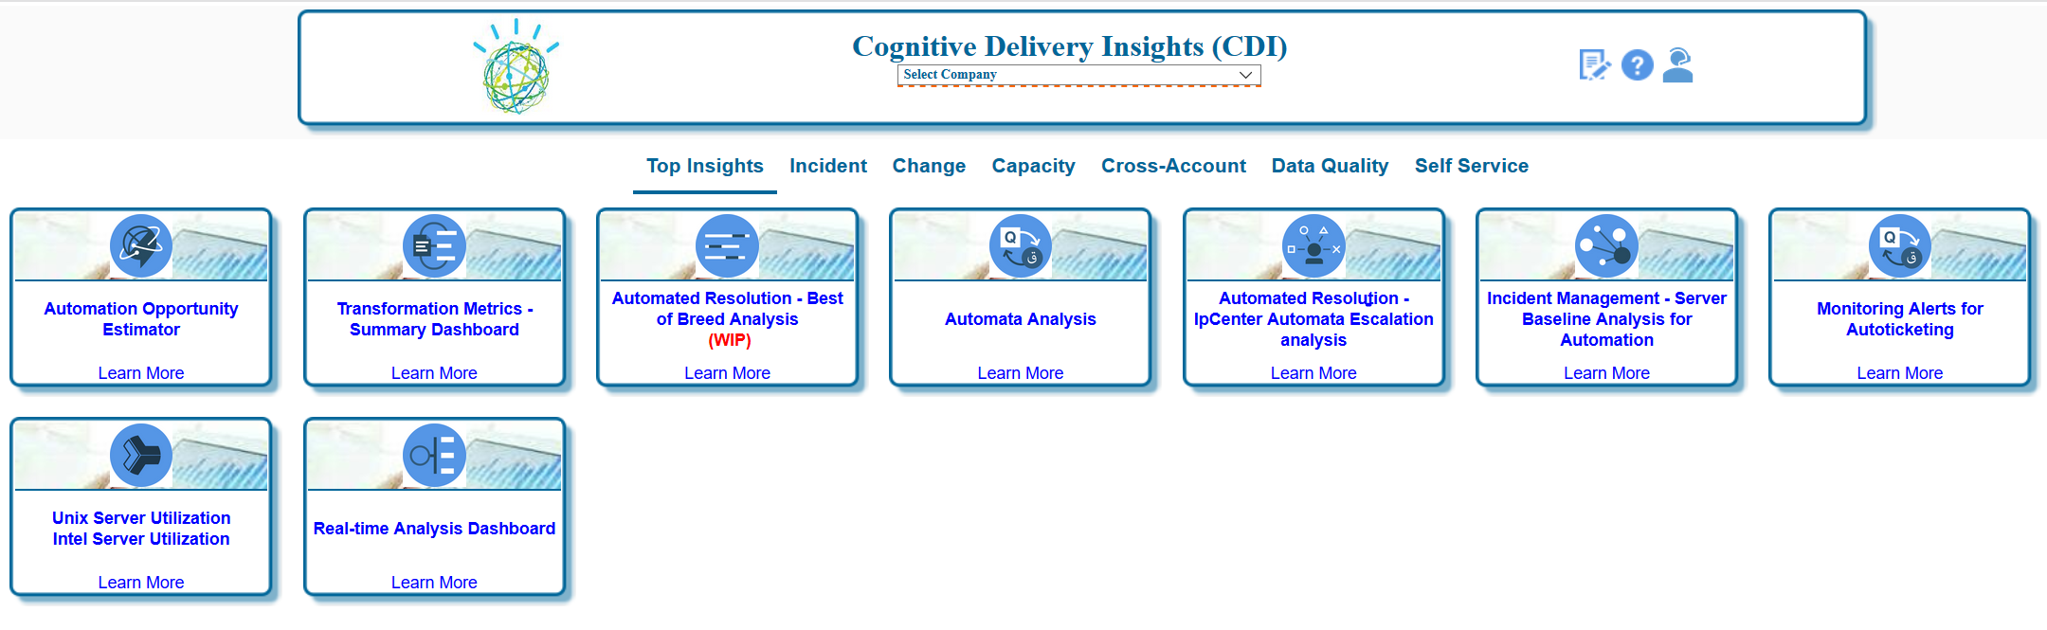
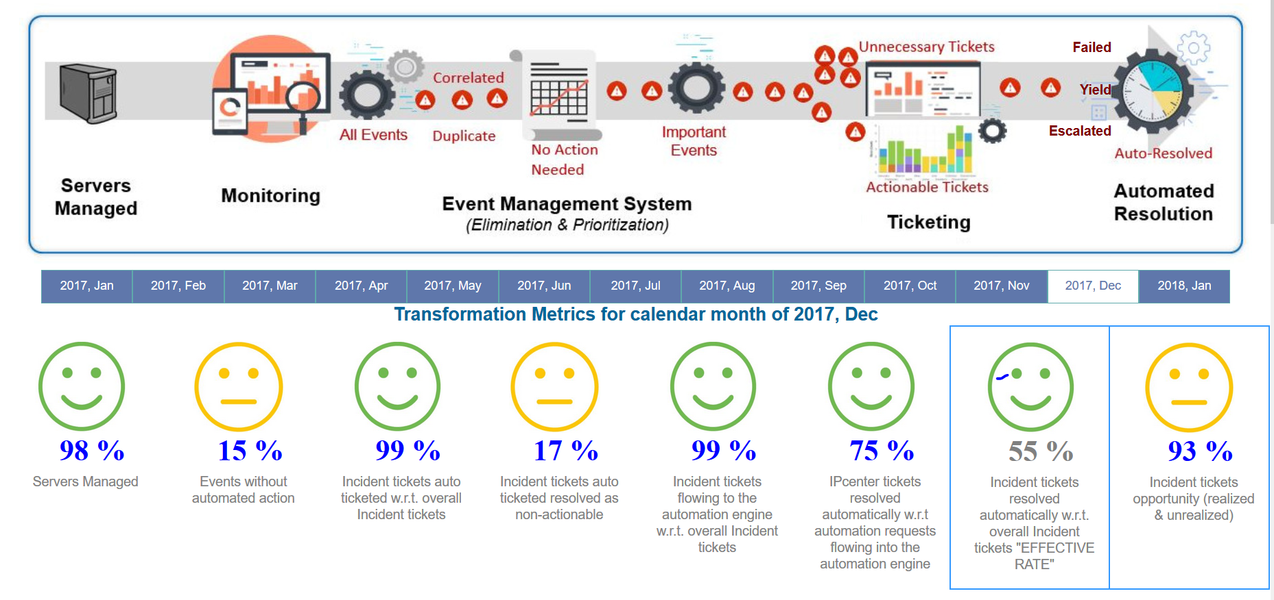
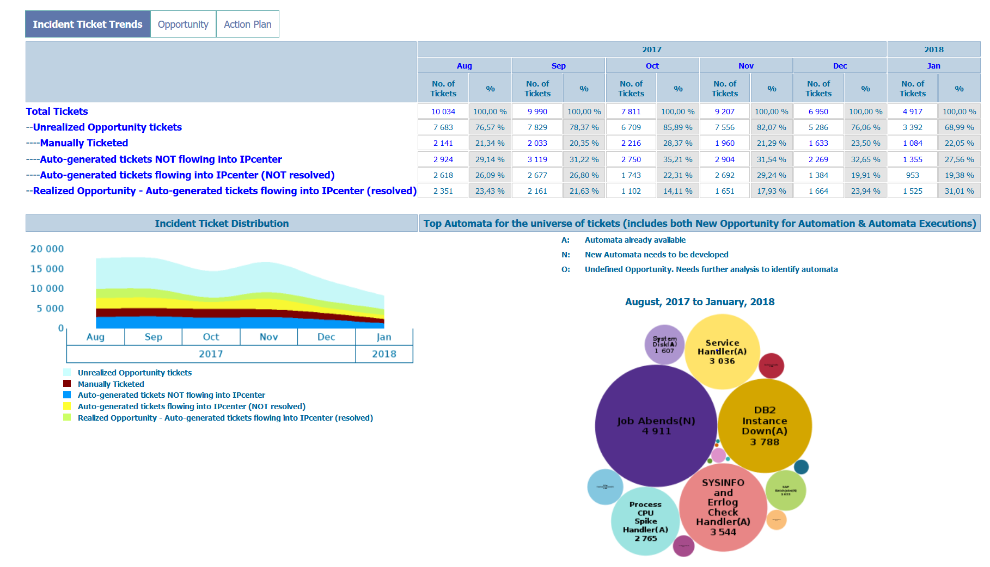
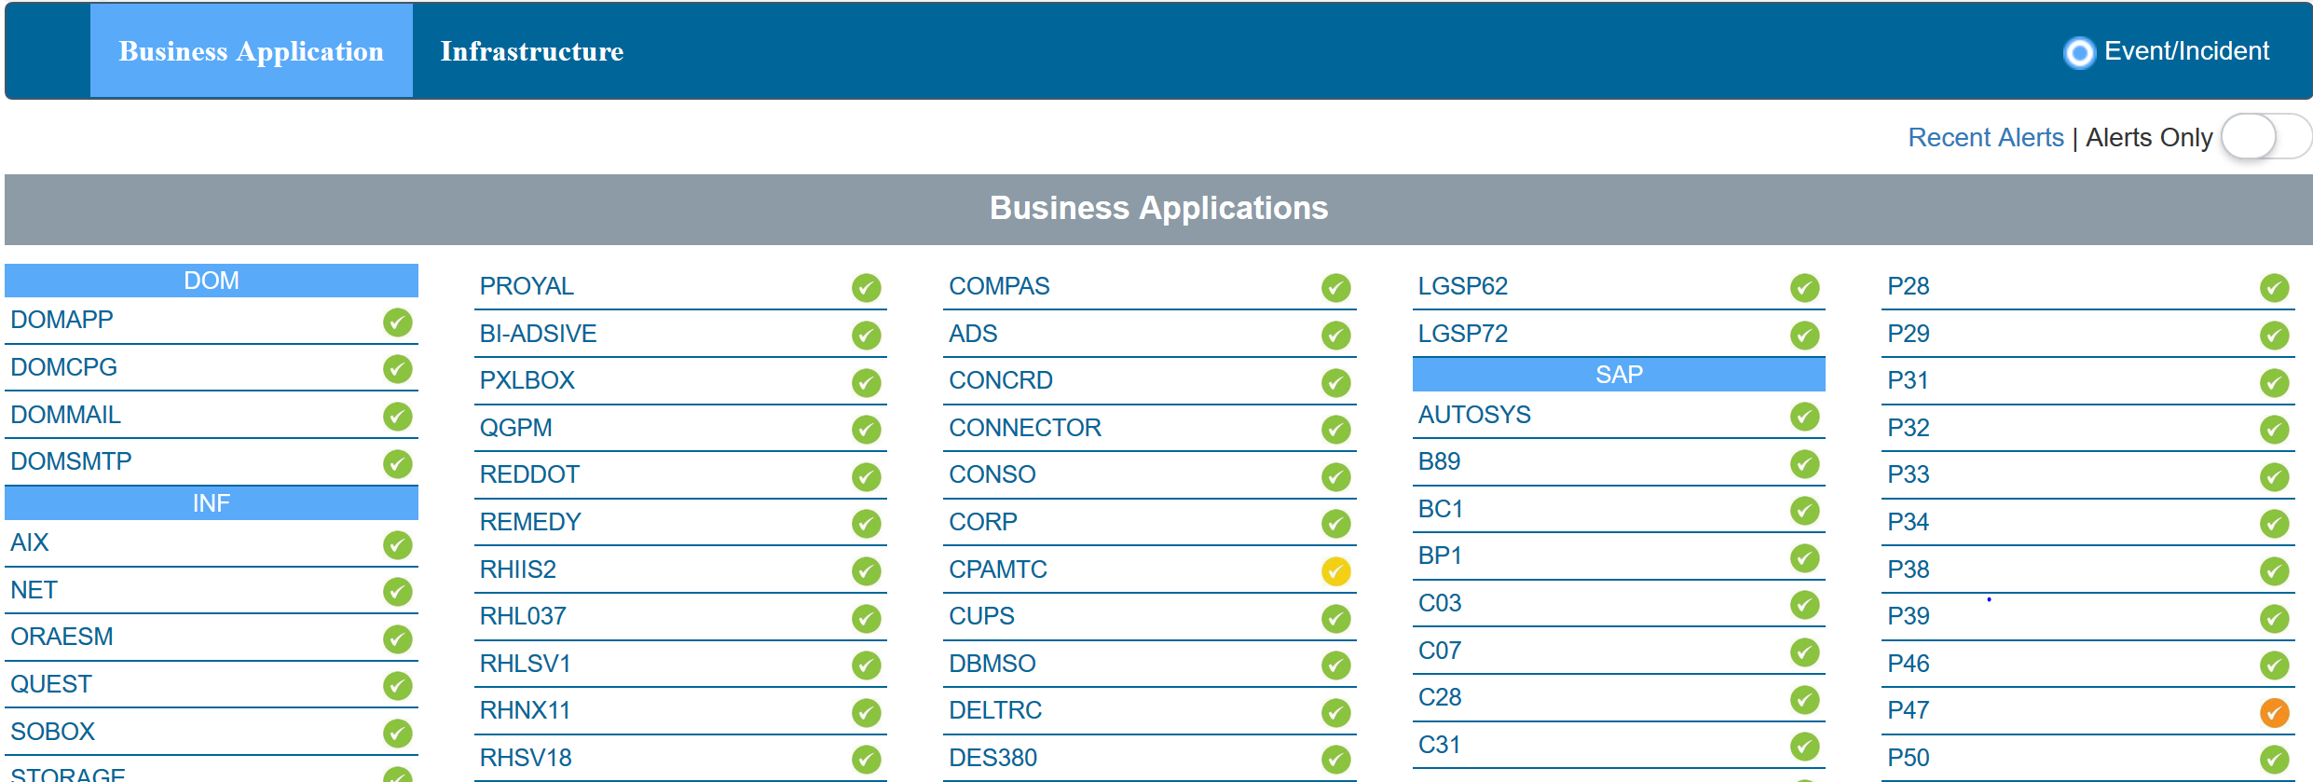
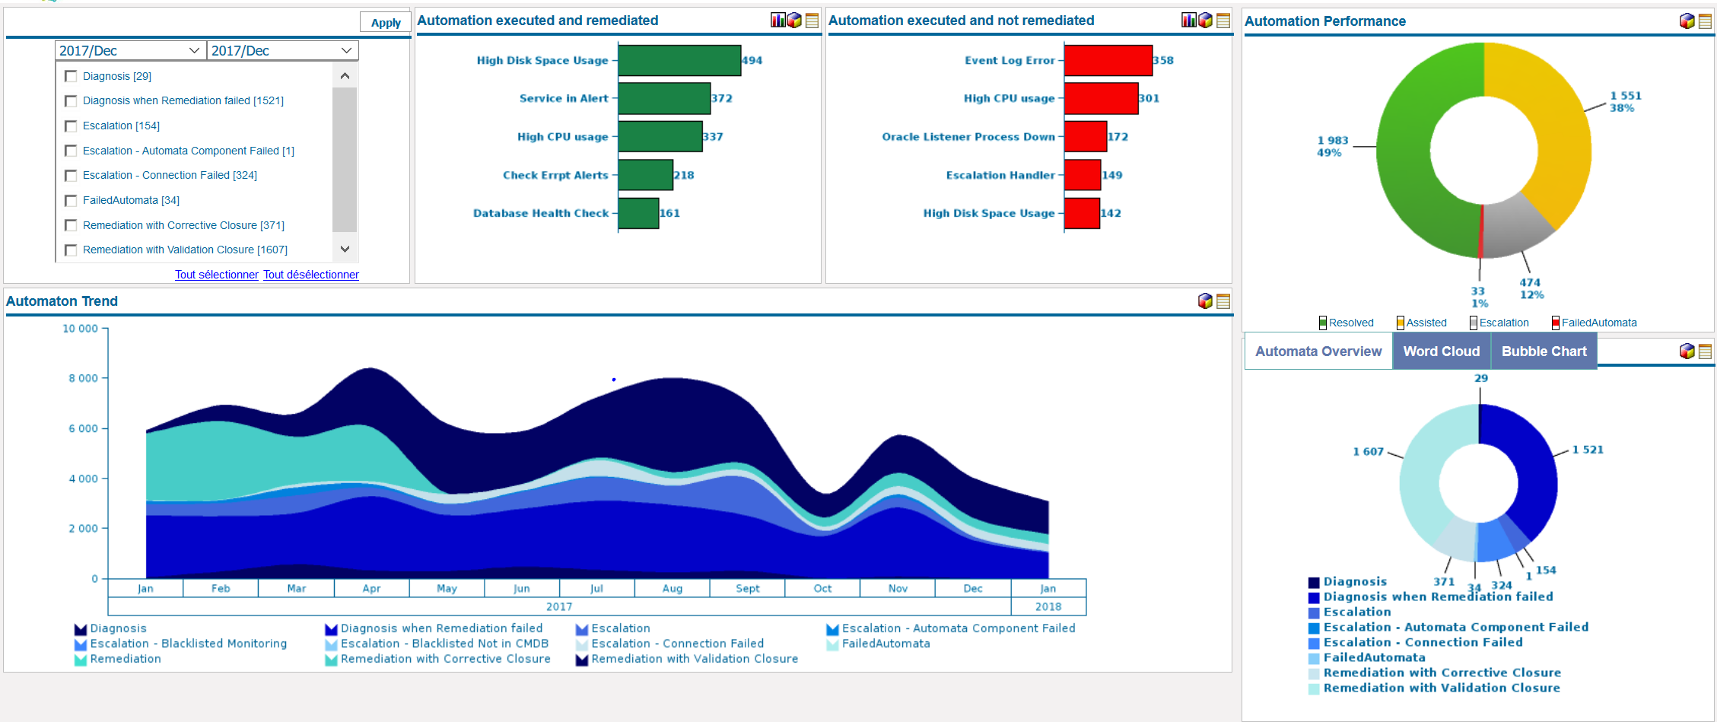
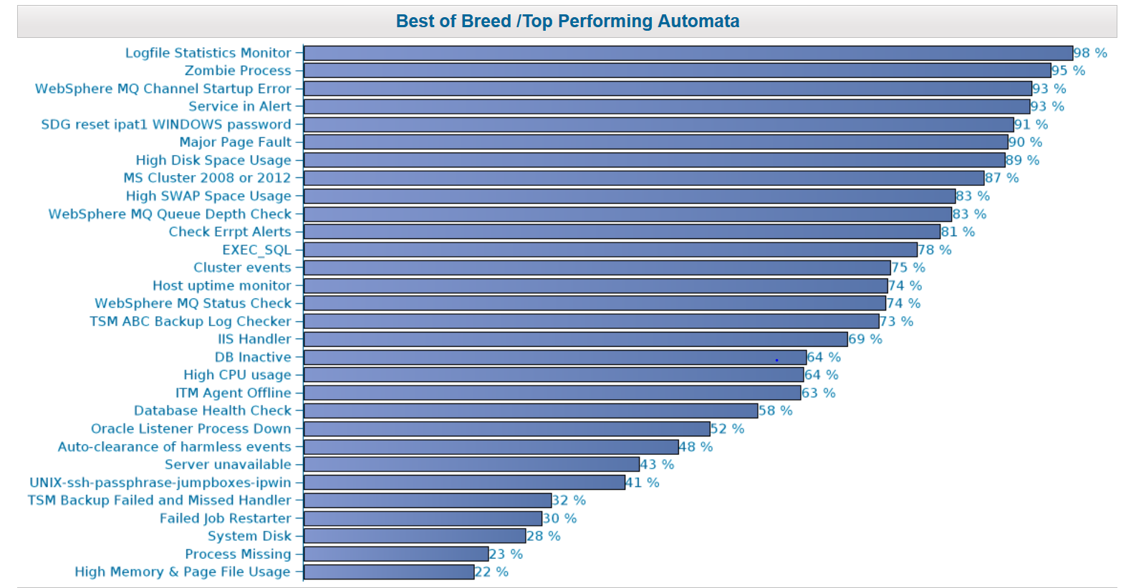
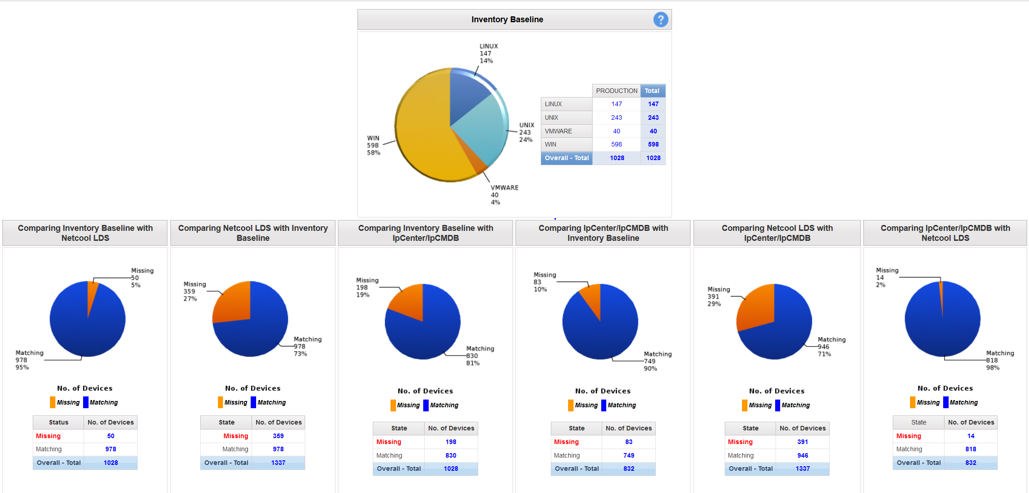
Examples of Insights (all insights are described here)
CDI – Insights catalogue
Dynamic Automation metrics dashboard
Opportunity estimator dashboard
Real time Analytics Dashboard
This application is having troubles. What are the on going actions?
What is the end to end status of Dynamic Automation? And what is the status step by step?
Success Story. What automation resolved
Here are areas where the account can improve its service.
Watson analytics view : These automata are available. They could be improvement opportunities for my environment
What automation did not resolve – improvement areas
Best of Breed dashboards
IPCenter - Automata execution dashboard
Different scope for the different tools .
Overall Performance.
What are the best of breed automata. Where are they deployed?

Slide 7






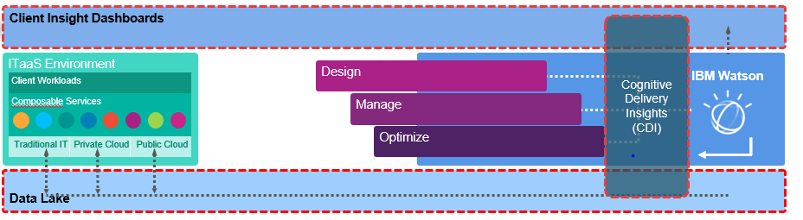
Delivery persona take advantage of CDI to understand service quality and drive service quality improvement
1
DPE gets a high level view of IT health different insights :
Real Time Analytics Dashboard : Applications and IT health
Transformation Metrics summary dashboard : Dynamic automation results
Comparison with other accounts
- Evidences of Service improvements / derailments through the Top Insight – incident ticket – top Symptoms (or transformation metrics dashboard - automation dashboard)
DPE
SAM / SIL
Delivery Analyst
Architect
Developer
1
2
3
4
5
2
SAM and SIL use the same insights than the DPE but access to detailed view to run improvement with the Delivery Analyst
3
Delivery Analyst gets a detailed view of service improvements areas within Automation, Monitoring / Event Management, Incident management and IT health
4
Architect is a technical advocate of the solution. She communicates with her technical counterpart in client’s organization and runs demos (using North America ACME account).
5
Developer will use CDI APIs to develop applications or dashboards

Slide 8
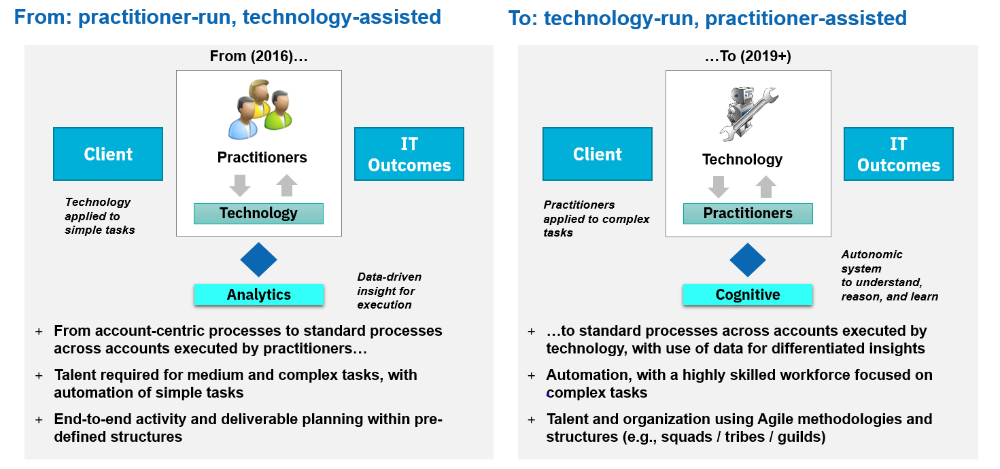
Value Proposition
As a key component of IBM Services Platform with Watson, CDI demonstrates the cognitive approach used by IBM GTS for the transformation of the operations of GTS managed accounts.
CDI show cases GTS strategy based on technology-run, practitioner-assisted model to meet increasing business demands
By combining multiple data sources to provide business intelligence about client environments.
Through insights that
show current service performance and where and how the service can be improved
provide high level dashboards but also very detailed ones and as such it is used by the different persona of the Delivery organization
Through an improved applications availability
An automation resolution of up to 40% of events
Clients experience up to 88% improvement in mean time to resolution for events that were automated.
Clients experienced 19 hours’ reduction MTTR based on 4 month average with 15 minutes average handle time for Dynamic Automation tickets
CDI Data Lake that is connected to a growing number of data sources types and data source instances (using first shared instances and then dedicated instances). These data sources leverage 30 years + of experience in managed services .

Slide 9
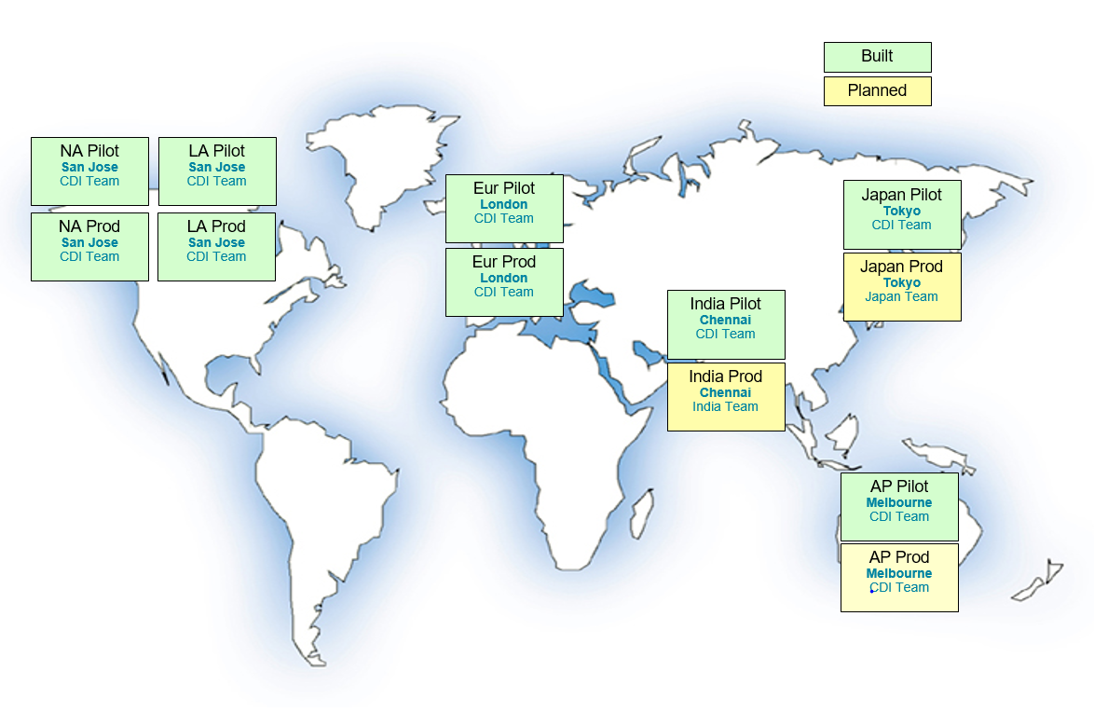
CDI is currently deployed as shared instances in different geographies in Bluemix infrastructure Data Centers
CDI is available :
in production in North America, Latin America, Europe and widely used (700 CDI registered accounts for Europe)
in pilot phase in India, Japan and AP. Production planned date is 3Q2018 for India and AP, 4Q2018 for Japan.
Each CDI production instance :
Is a shared instance that is hosted off-premise in Bluemix Infrastructure Data Centers (former called Softlayer Data Centers) in the Restricted Yellow Zone VLAN
Is a multi-tenancy database – for a particular CDI Instance many accounts have their data loaded in to a single database, and share the same schemas.
Has a data lake and CDI insights.
A client
will generally be boarded on the local geography instance of CDI unless required otherwise
will enable the integration with CDI and its on premise data sources via the IBM GSNI network

Slide 10
Selection Strategy Guidance for Cognitive Delivery Insights
It is now mandatory to include Cognitive Delivery Insights (CDI) in all GTS solutions
The only likely exception will be where data sovereignty or data security and privacy constraints preclude the use of off-shore or multi-tenant services
CDI delivery model varies from a geography to another
For Europe, the ability to have a delivery model with only European Economic Area (EEA) people is being set in place
For NA, the ability to have a delivery model with only USA people is being set in place
For AP in many cases the CDI delivery model will be out of country / off-shore
For Japan, CDI instance and data lake are currently maintained from off-shore country
CDI is a shared service and is only hosted in selected IBM data centers :
As long as key restrictions such as - data is not stored or processed outside of the IOT and may not be viewed by personnel who are not from the IOT or on an ‘approved list’ of countries - the account could be boarded on CDI as a Restricted account in Europe and NA with the associated delivery model. Only Users explicitly authorized to that account may see the data for that account. Users with above Account authorization may not see the account unless they are also explicitly authorized to that account i-e by the DPE.
for clients who are not willing, under any circumstance (because of regulatory constraints or data privacy laws or any additional security policies and regulation of some industries) to board shared CDI instances : a stand alone CDI – also called ‘CDI in a can’ - could be seen as a potential future solution. This requirement is not planned in the current 2018 roadmap
CDI holds and stores operational data about the client’s IT environment :
generally, the data within CDI does not include the client’s customer data or business data. CDI does not explicitly collect or manage either Sensitive Personal Information (‘SPI’) or Personal Information (‘PI’).
CDI stores IP addresses and Fully Qualified Host Names (FQHN) that are not considered to be PI data as these are not traceable back to an individual but are considered to be ‘sensitive’ data.
A security White paper for both Data Lake and CDI is planned in 1Q2018 (Requirement 340877 in RTC)

Slide 11
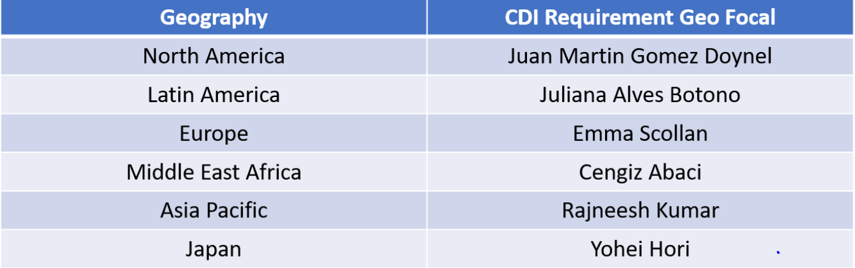
Typical Scenarios to Consider
Once questions about data sovereignty, security and privacy are answered, the main variation between accounts will be in the selection of data sources to be connected into Cognitive Delivery Insights
IBM standard tools versus client specific tools
Shared versus dedicated instances of IBM tools
For Cognitive Delivery Insights to be effective you must integrate at least three primary data sources
Asset data
Ticket data
Event data
Additionally, it is highly recommended that automation performance data also be fed into CDI
Dynamic Automation
CDI focal point of your geography
Client-specific tools and data sources can potentially be accommodated by CDI – however they may require new or modified integration mechanisms or ETLs to be developed.
Check with the CDI focal point of your geography before committing to integrate data from an unusual data source or non-standard tool.
Ask your CDI focal point to open a requirement here and provide him/her the right information and prioritization to raise this requirement. Your focal point is your representative in the global CDI board.

Slide 12
Cognitive Delivery Insights – Key Data Sources
1 – Asset Data
3 – Event Data
Asset Management
Hardware Asset tracking (ATP)
Software License Mgmt. scans(BRAVO)
Utilization/Performance Management
SRM utilization characteristics on CPU, memory, network, IO 15 min samples
Event Management
Netcool Alerts/Events from ITM monitoring enabled on endpoints
Automation Executions
IPCenter, SEA, IEM, CHEF – automata executions to auto resolve tickets
Configuration Management
Logical devices, storage, network, middleware (GACDW, SESDR, SysReg. CCMDB etc)
4 – Automation
2 – Ticket Data
Storage Management
Storage configurations, firmware levels, health checks etc. USIBRS, HW/SW currency, IOPS etc
Incident Management
Incident tickets from ISM, ServiceNow, Remedy etc.
Cognitive Delivery Insights
Data, Knowledge & Insights Hub
Problem Management
Problem tickets from ISM, ServiceNow, Remedy etc.
Middleware/Applications
SSDW, CCMDB, BRAVO, IEM etc.
Endpoint Management
End point scans on configurations, automata executions etc. IEM / BigFix, SEA, BlueWisdom etc.
Change Management
Change Requests from ISM, ServiceNow, Remedy etc.
Service Desk Tickets
Source include MCCSD etc.
Labor, Productivity, Cost & Quality Metrics
TvC, CMT, BMSIW – labor metrics, CHIP,CLAIM, RCA, Service Levels etc.
Security & Compliance Management
Health check violations, Identity & access mgmt. and patch mgmt. scans etc. ECM, UAT , IEM etc.
Recommended minimum data sources highlighted in RED

Slide 13
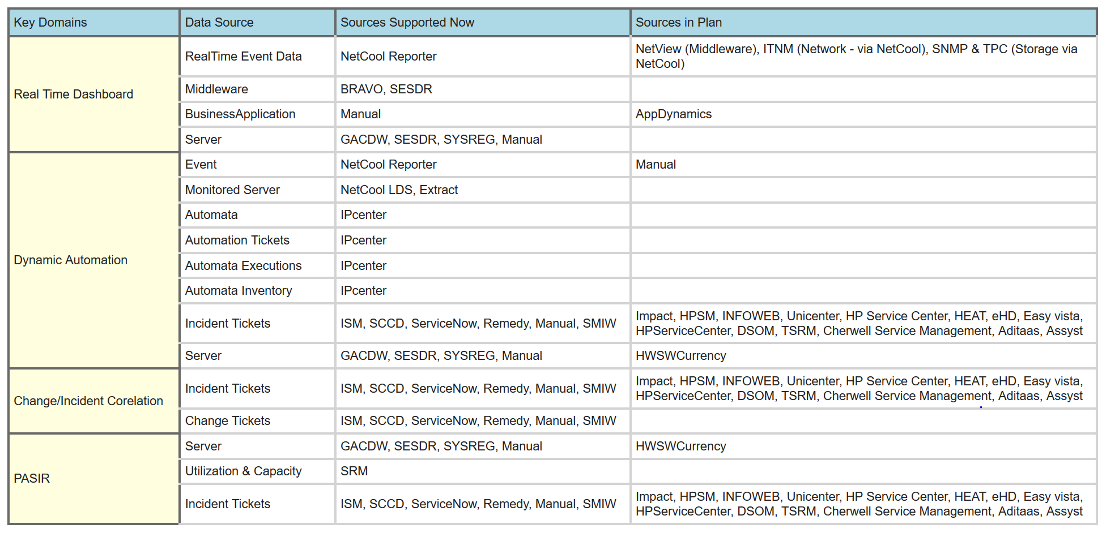
This list details the Data Sources that are required to feed data to CDI for an account to be deemed Enabled (here)

Slide 14
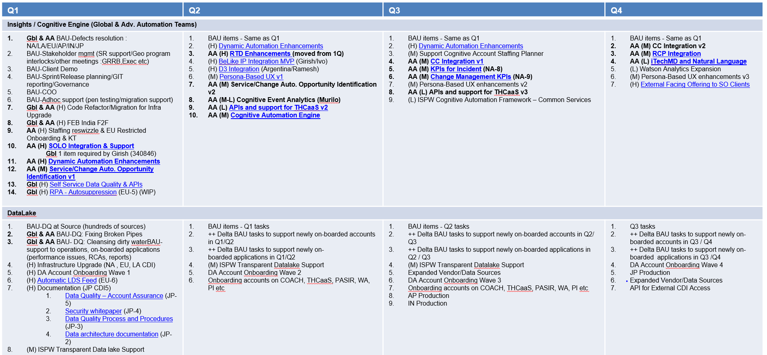
CDI roadmap for 2018 (1 of 2)
CDI 2018 roadmap and cue card is available here

Slide 15
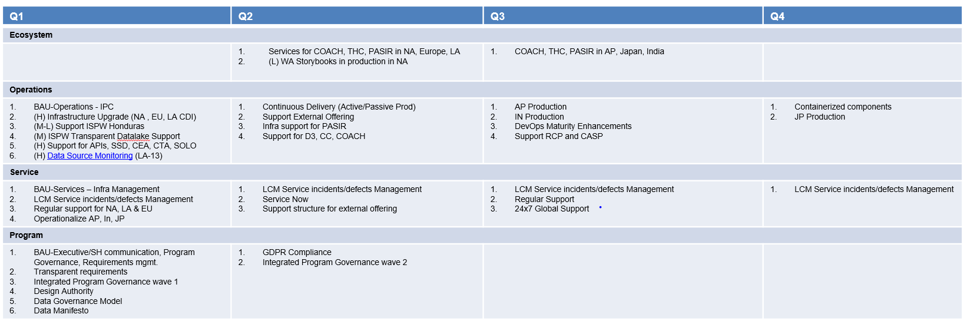
CDI roadmap for 2018 (2 of 2)
CDI 2018 roadmap and cue card is available here

Slide 16

Technical Design – IBM Implementation
The customer network must be connected to GSNI to enable the integration with the CDI of the associated geography as shown in the high level overview of CDI Logical network Architecture
CDI w3 User
User restricted to specified account and authorised Insights only.
L2 Support
Operational Support
BluePages
Non-GR Resource
Non-GR Resource
where privileged access may lead to access to data
IBM Bluemix infrastructure
Restricted Yellow Zone VLAN
Blue Groups
IBM Bluemix infrastructurer
DevTest Yellow Zone VLAN
IPSec VPN
CDI Pilot Infrastructure
CDI DevTest Infrastructure
CDI Prod Infrastructure
Proxy
Proxy
Operational Support
Dev and Test
Cust Network
9. Network
GSNI Network
GR Resource
GR Resource
Data
Data
Data
Data

Slide 17
Scoping and Estimating
CDI does not require any cost to be added into SDM.
The costs for CDI are charged to Delivery at the IOT level.

Slide 18
Implementation Guidance
Account boarding on CDI must be approved by the DPE who will validate that the customer’s data sovereignty or data security and privacy constraints match with the use of a shared CDI instance and associated delivery model
The boarding template is to be fulfilled by the DPE with the information of the primary data sources (asset, ticket, event and automation data) and the boarding contact point of your geography is to contacted with this boarding template
The boarding of the account is done on CDI production instance

Slide 19
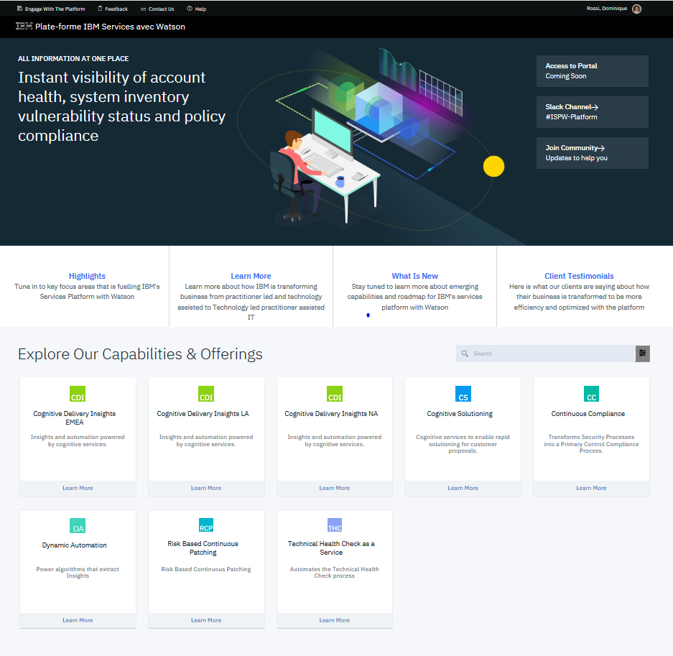
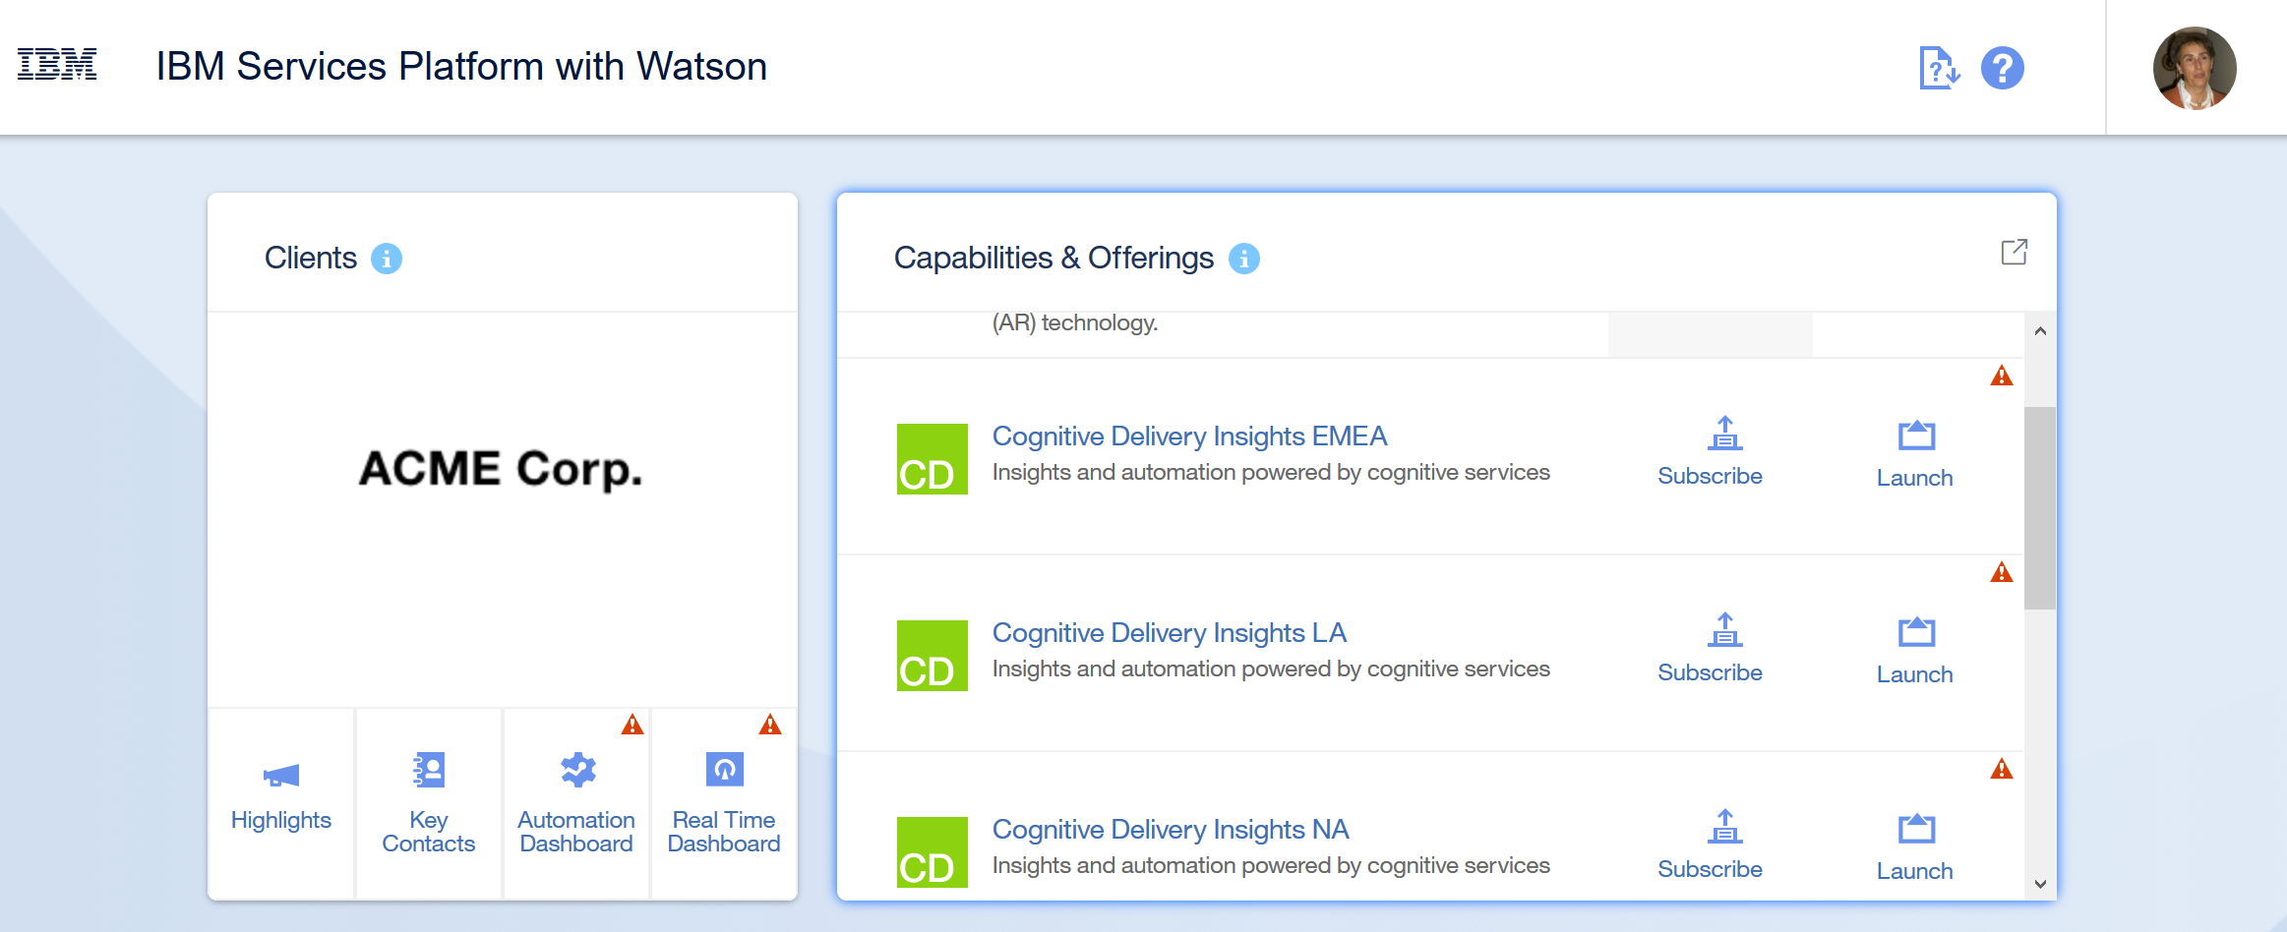
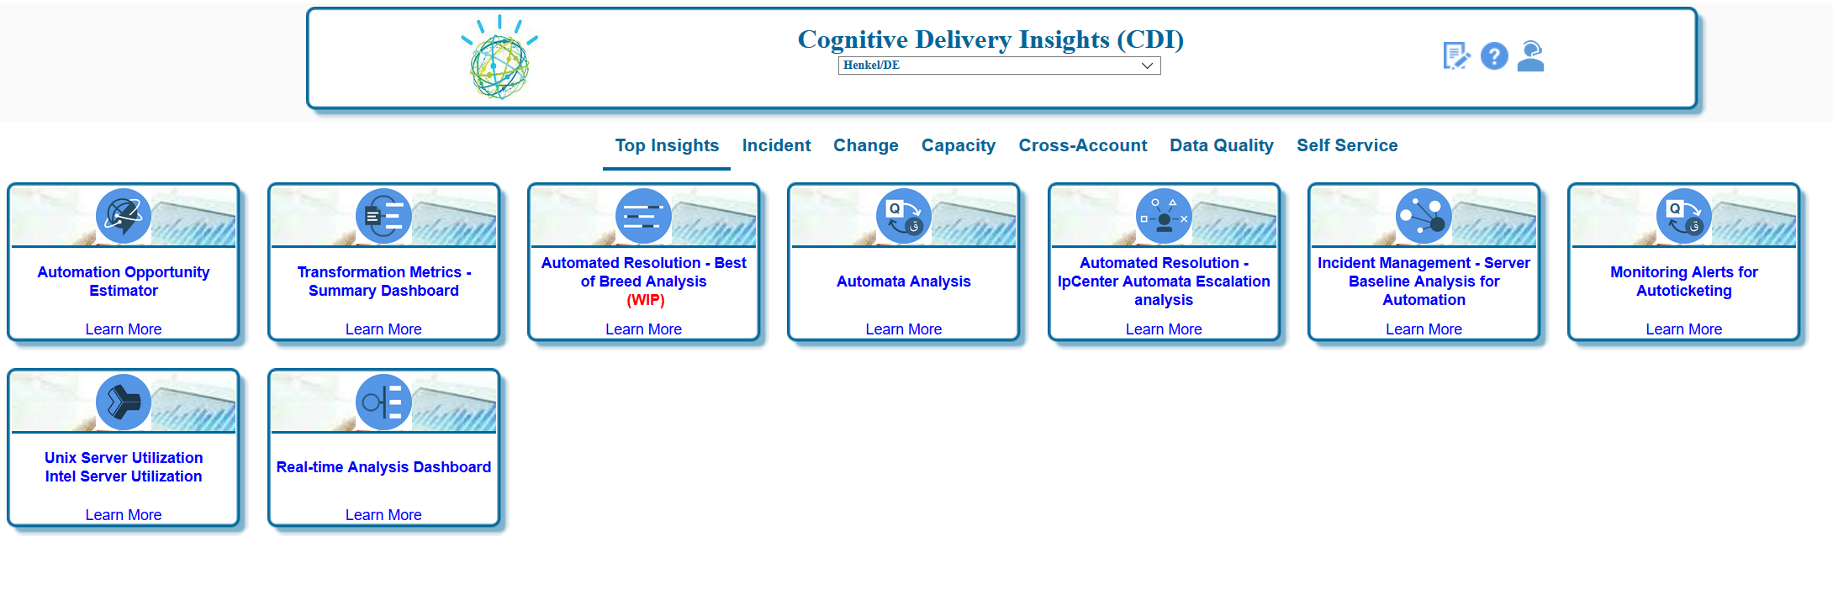
Access to CDI will be shortly provided through IBM Services Platform with Watson
IBMers can get access to IBM Services Platform with Watson through this link .
Access to the CDI production instances is to be required according to Business Needs : link

Slide 20
Additional Resources – Supporting Materials
Title | Description | Link
CDI Wiki | GTS CDI community (previously named GTS SDI) | https://w3-connections.ibm.com/communities/service/html/communitystart?communityUuid=01328406-a6c9-4e77-a0c1-552def94dd74
CDI Wiki Japan |  | https://apps.na.collabserv.com/wikis/home?lang=en-us#!/wiki/W7974ba5f1da8_466c_ac97_7b8084b6b9f4
CDI Education |  | https://w3-connections.ibm.com/wikis/home?lang=en-us#!/wiki/W792382fe62dd_4a4f_823c_93d42daa2978/page/Education%20Materials
CDI Access | Link to procedure to get access to a CDI instance - for demo ask for ACME account | https://w3-connections.ibm.com/wikis/home?lang=en-us#!/wiki/W226cbefa8da4_4bc2_965c_36e6e5ebf100/page/GTS-SDI%20Requesting%20User%20Access
CDI on boarding | CDI onboarding process for the different geographies and deployment contact points | https://w3-connections.ibm.com/wikis/home?lang=en-us#!/wiki/W792382fe62dd_4a4f_823c_93d42daa2978/page/Account%20Onboarding%20Procedure
CDI on boarding data sources | Data Sources that are required to feed data to CDI for an account to be deemed Enabled | https://w3-connections.ibm.com/wikis/home?lang=en-us#!/wiki/W792382fe62dd_4a4f_823c_93d42daa2978/page/Data%20Sources%20required%20for%20enabling%20an%20Account%20to%20CDI
CDI Support team | CDI geography support contact | https://w3-connections.ibm.com/wikis/home?lang=en-us#!/wiki/W792382fe62dd_4a4f_823c_93d42daa2978/page/Contacts
CDI roadmap | CDI Roadmap for 2018 for both insights and data lake and CDI cue cards presentation for 1Q2018 - the presentation highlights some of the enhancements that will be delivered in 1Q2018 | https://w3-connections.ibm.com/wikis/home?lang=en-us#!/wiki/W792382fe62dd_4a4f_823c_93d42daa2978/page/GTS-CDI%20Roadmap
CDI requirements | Open a requirement | https://w3-connections.ibm.com/wikis/home?lang=en-us#!/wiki/W792382fe62dd_4a4f_823c_93d42daa2978/page/Requirements
CDI video | Short video of CDI on Youtube | https://www.youtube.com/watch?v=kox7tBlSbq0
CDI security | Security - Restricted accounts | https://w3-connections.ibm.com/wikis/home?lang=en-us#!/wiki/W792382fe62dd_4a4f_823c_93d42daa2978/page/CDI%20Restricted%20Accounts

Slide 21
Additional Resources – Supporting Materials
Title | Description | Link
IBM Services Platform with Watson | Community | https://w3-connections.ibm.com/communities/service/html/communitystart?communityUuid=29e9d76a-2c64-4c7d-ab10-17425c2dd6d6
IBM Services Platform with Watson | Wiki | https://w3-connections.ibm.com/wikis/home?lang=en#!/wiki/Cognitive%20Technology%20Solutions%20Platform/page/IBM%20Services%20Platform%20with%20Watson
IBM Services Platform with Watson Portal | Link to IBM Services Platform with Watson (Belize level as of Jan 15th) | https://ispw.w3cloud.ibm.com/services/ctsp/
IBM Services Platform with Watson Portal | Link to IBM Services Platform with Watson (Honduras level that will be made available in production by end of January 2018) | https://105.w3cloud.ibm.com/services/ctsp/common

Slide 22
Additional Resources – Contacts
Function | Scope | Role / Contact
Design | Global | Program Director – Andrew Tollerud/Santa Teresa/IBM Project management : Venkataraman H12/India/IBM, Karen Cheng/Markham/IBM, Sampoorna Hegde/India/IBM Development Manager – Girish B Mohite/India/IBM Director of Development : Arun Hampapur/Watson/IBM Operations and Support Manager – Kiranmai Kuchibotla/India/IBM Chief Architect and Director of CDI Technology – Naga Ayachitula/Watson/IBM Chief Data and Security Architect – Jim Hunter/UK/IBM, Ramesh C Pathak/India/IBM,
Deployment – boarding (here) | NA, LA, Europe | Boarding contact – Sheila McFarlane/UK/IBM
 | MEA, India, AP | Boarding contact – Bipin Borgohain/India/IBM
 | Japan | Boarding contact – Narendra Singh5/India/IBM
Geography – Focal Point | NA | Juan Martin Gomez Doynel/Argentina/IBM,
 | LA | Juliana Alves Botono/Brazil/IBM,
 | Europe | Emma Scollan/Ireland/IBM,
 | MEA | Cengiz Abaci/Turkey/IBM,
 | AP | Abhay Goyal2/India/IBM,
 | Japan | Yohei Hori/Japan/IBM,

Slide 23
Contacts
CDI North America Program Managers
CDI Champions in support of North America accounts
CDI Program Managers drive CDI deployment and adoption across all NA accounts
CDI Champions are local support which help employees at our different locations supporting North American Accounts. They act as a link between NA Program Managers and our Delivery teams
CIC | Sector | Champions
Argentina | All | MURIAGO, MARTIN ALEJANDRO​ BALZANO, GISELLE GEORGINA​
Brazil | All | FERRARETO JAYME, RICARDO​ ALFENAS REIS, THIAGO HERMANO DE​
Canada | Canada | Derrick, Loren (L.A.)​
Costa Rica | All | Lin Lin Tho, Andres​ Gonzalez Soto, Daniel Gustavo​
India | Canada | Rao, Sudhindra​ SRIDHARAN, PRASANNA​
India | Industrial | KASHYAP, SANDEEP (SANDEEP)​
India | Financial | KUMAR, VINAY V (VINAY)​ Shetty, Nithesh R​
India | Communications | Paul, Uday K​
India | Public | Lingegowda, Nagesha H​
India | Distribution | Nanduri, Sirisha​
USA | All | Chumbley, Heather S (Heather)​ Izadi-Moghadam, Aaron (Sage)​ TACKETT, RITA (Rita)​
Juan Martin Gomez Doynel
Darlene Ericson
07
John Hoffman

Slide 24

Thank you!
For more information, please visit:
http://www.ibm.com

